Slide 1
Micro Credit Defaulter Project Presentation
Submitted By | Anubhav Saxena
Data Science Intern at Flip Robo Technologies

Slide 2

Introduction
Problem Statement:
Microfinance Institutions (MFIs) are businesses that provide financial services to low-income people. When addressing unbanked poor families living in rural places with few sources of income, MFS becomes quite effective. Group Loans, Agricultural Loans, Individual Business Loans, and other Microfinance Services (MFS) are some of the Microfinance Services (MFS) provided by MFI. Many microfinance institutions (MFI), experts, and donors promote the use of mobile financial services (MFS), which they believe are more convenient, efficient, and cost-effective than the traditional high-touch strategy used to deliver microfinance services for a long time. Despite the fact that the MFI industry focuses primarily on low-income households and is extremely beneficial in these areas, MFS implementation has been unequal, with both considerable obstacles and triumphs.

Slide 3
Introduction
Microfinance is now widely recognized as a strategy for poverty reduction, with $70 billion in outstanding loans and a global client base of 200 million people. We are now working with a client in the telecom industry. They are a provider of fixed wireless telecommunications networks. They've released a number of products and built their business and organization around the budget operator model, which entails providing better products at lower prices to all value-conscious clients via a disruptive innovation strategy that focuses on the subscriber. They recognize the value of communication and how it influences a person's life, thus they focus on giving low-income families and impoverished consumers with services and products that can assist them in their time of need. They've teamed up with a microfinance institution to offer micro-credit on mobile balances that must be paid back in five days. The If a customer deviates from the course of repaying the lent amount within five days, he is considered a defaulter. The payback amount for a loan of 5 (in Indonesian Rupiah) should be 6 (in Indonesian Rupiah), whereas the payback amount for a loan of 10 (in Indonesian Rupiah) should be 12. (in Indonesian Rupiah).

Slide 4

Exercise
Build a model that can be used to predict if a client will pay back the lent amount within 5 days of loan insurance in terms of probability for each loan transaction.
Label '1' shows that the loan has been paid, indicating that it is a non-defaulter, whereas Label '0' indicates that the loan has not been paid, indicating that it is a defaulter.

Slide 5
Points to remember
The dataset has no null values.
There may be some consumers who have never had a loan before.
The data set is skewed. Label '1' has roughly 87.5 percent of the records, whereas label '0' has roughly 12.5 percent.
There may be values for some aspects that aren't practical. You may need to keep an eye on them and provide an appropriate explanation.
You may encounter outliers in various characteristics, which you must treat according to your knowledge. Keep in mind that data is expensive, and we can't afford to lose more than 8% of it.

Slide 6
Project Goals
Analytical Problem Framing
Exploratory Data Analysis (EDA)
Visualizations
Data Pre-Processing on train and test datasets
Model/s Development and Evaluation
Performing hyper parameter tuning, saving the best model and predicting the label
Conclusion and future work discussion

Slide 7
Technology
Hardware technology being used.
RAM : 8 GB
CPU : Intel(R) Core(TM) i3-7100U CPU @ 2.40GHz 2.40 GHz
Software technology being used.
Programming language : Python
Distribution : Anaconda Navigator
Browser based language shell : Jupyter Notebook
Libraries/Packages specifically being used.
Pandas , NumPy, matplotlib, seaborn, scikit-learn, pandas-profiling, missingno

Slide 8
Data Description
label : Flag indicating whether the user paid back the credit amount within 5 days of issuing the loan {1:success, 0:failure}
msisdn : Mobile number of user
aon : Age on cellular network in days
daily_decr30 : Daily amount spent from main account, averaged over last 30 days (in Indonesian Rupiah)
daily_decr90 : Daily amount spent from main account, averaged over last 90 days (in Indonesian Rupiah)
rental30 : Average main account balance over last 30 days
rental90 : Average main account balance over last 90 days
last_rech_date_ma : Number of days till last recharge of main account
last_rech_date_da : Number of days till last recharge of data account
last_rech_amt_ma : Amount of last recharge of main account (in Indonesian Rupiah)
cnt_ma_rech30 : Number of times main account got recharged in last 30 days
fr_ma_rech30 : Frequency of main account recharged in last 30 days

Slide 9
Data Description
sumamnt_ma_rech30 : Total amount of recharge in main account over last 30 days (in Indonesian Rupiah)
medianamnt_ma_rech30 : Median of amount of recharges done in main account over last 30 days at user level (in Indonesian Rupiah)
medianmarechprebal30 : Median of main account balance just before recharge in last 30 days at user level (in Indonesian Rupiah)
cnt_ma_rech90 : Number of times main account got recharged in last 90 days
fr_ma_rech90 : Frequency of main account recharged in last 90 days
sumamnt_ma_rech90 : Total amount of recharge in main account over last 90 days (in Indonesian Rupiah)
medianamnt_ma_rech90 : Median of amount of recharges done in main account over last 90 days at user level (in Indonesian Rupiah)
medianmarechprebal90 : Median of main account balance just before recharge in last 90 days at user level (in Indonesian Rupiah)
cnt_da_rech30 : Number of times data account got recharged in last 30 days
fr_da_rech30 : Frequency of data account recharged in last 30 days
cnt_da_rech90 : Number of times data account got recharged in last 90 days

Slide 10
Data Description
fr_da_rech90 : Frequency of data account recharged in last 90 days
cnt_loans30 : Number of loans taken by user in last 30 days
amnt_loans30 : Total amount of loans taken by user in last 30 days
maxamnt_loans30 : Maximum amount of loan taken by the user in last 30 days
medianamnt_loans30: Median of amounts of loan taken by the user in last 30 days
cnt_loans90 : Number of loans taken by user in last 90 days
amnt_loans90 : Total amount of loans taken by user in last 90 days
maxamnt_loans90 : Maximum amount of loan taken by the user in last 90 days
medianamnt_loans90: Median of amounts of loan taken by the user in last 90 days
payback30 : Average payback time in days over last 30 days
payback90 : Average payback time in days over last 90 days
pcircle : Telecom circle
pdate : Date

Slide 11
Exploratory Data Analysis
Shape : 2,09,593 rows and 37 columns
No null values present
Only one duplicate row/record found
Datatypes of float, integer and object are in dataset
First, I loaded the complete dataset into our Jupyter Notebook after importing the appropriate libraries and renaming the project file from untitled.
Then I looked at the layout of our data and saw that we have 2,09,593 rows and 37 different columns.
In our dataset, there are no null or missing values.
In our dataset, there was only one duplicate row/record, which I eliminated.
I discovered that our data set has columns with float, integer, and object data type values by looking at the data types.

Slide 12
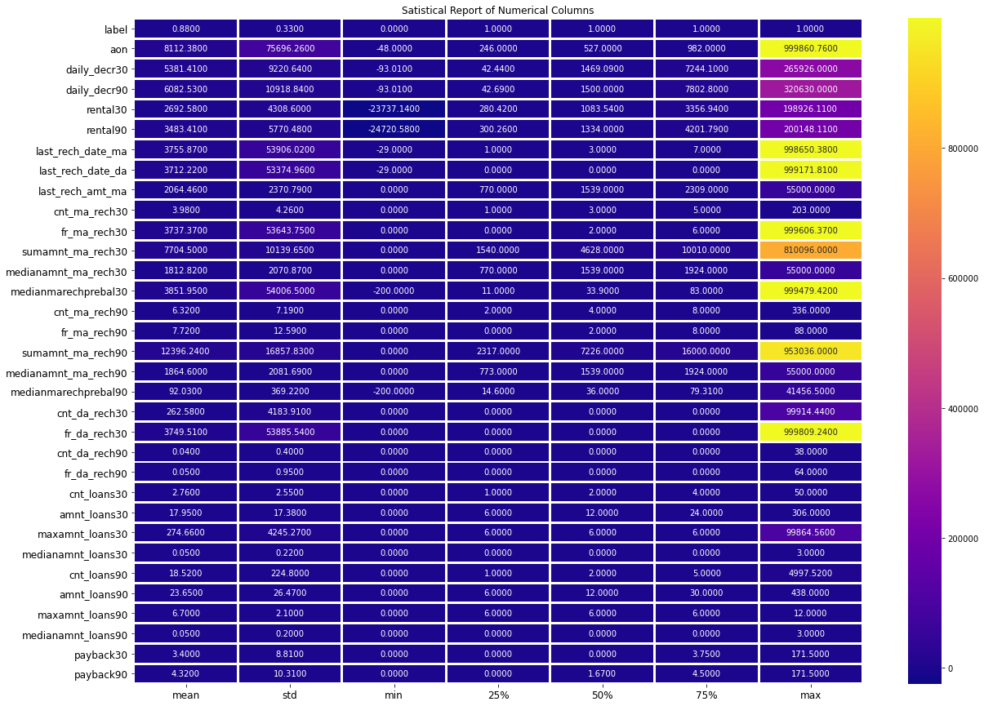
Describe
A statistical representation of all the numeric data columns may be found here.

Slide 13
Univariate Analysis
I was able to determine the total number of rows covered by each unique category value contained in all columns of our dataset using count plots. I made sure that the proportion of data coverage is presented with the overall row number.

Slide 14
Bivariate Analysis
We can observe the success and failure label data for the columns, which is basically the feature data, using Bar Plot.

Slide 15
Bivariate Analysis
I tested the object data type for date and mobile number data in our dataset using line plots.

Slide 16
Bivariate Analysis
We evaluated the success and failure label data points, as well as their variances and distributions, using the scatter plot to corroborate further analysis and outlier data.

Slide 17
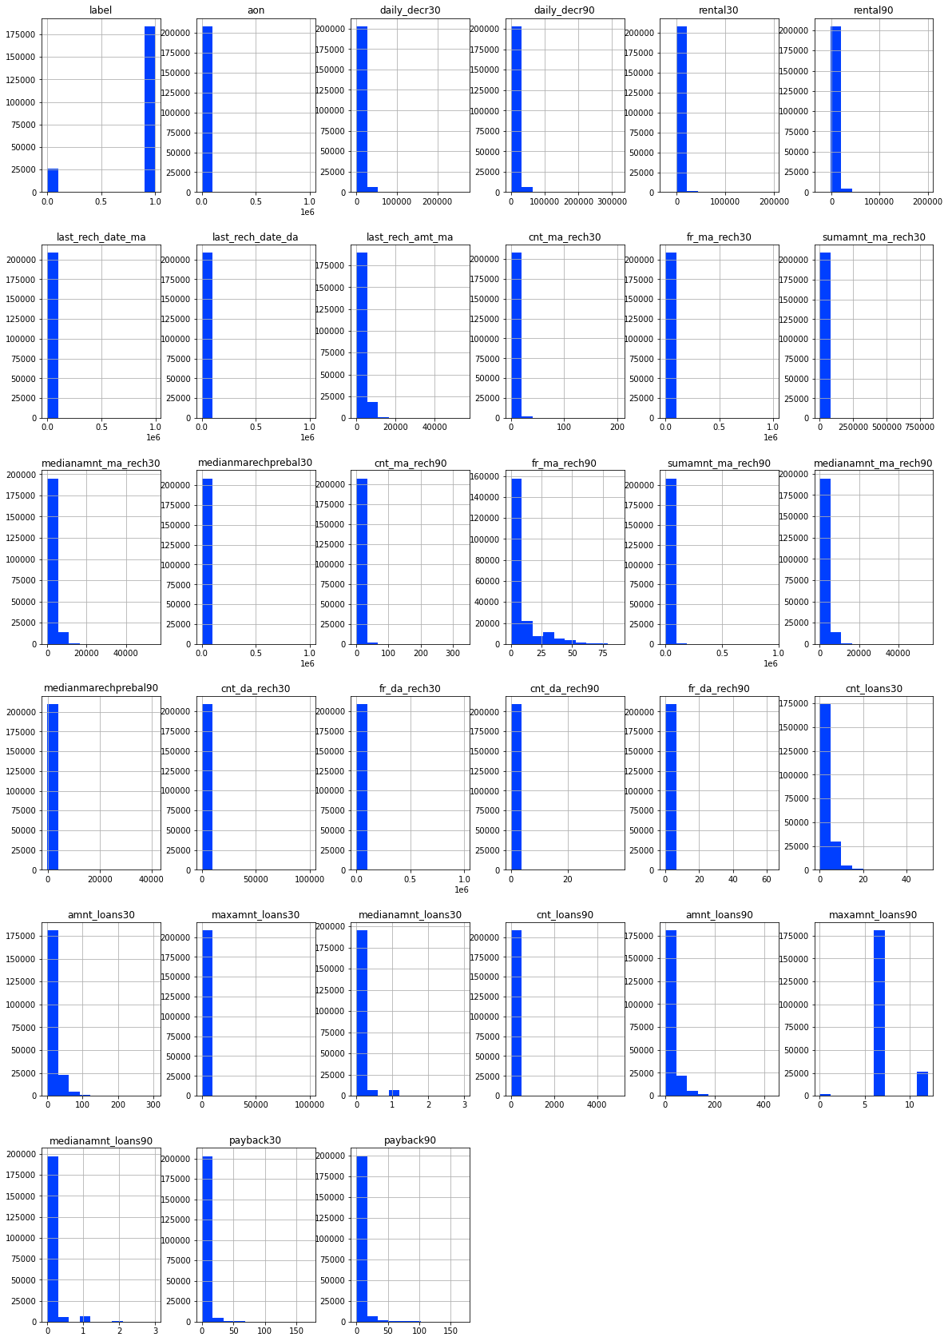
Multivariate Analysis
I checked all of the column details with the histogram to ensure that the distribution was displayed for additional investigation.

Slide 18
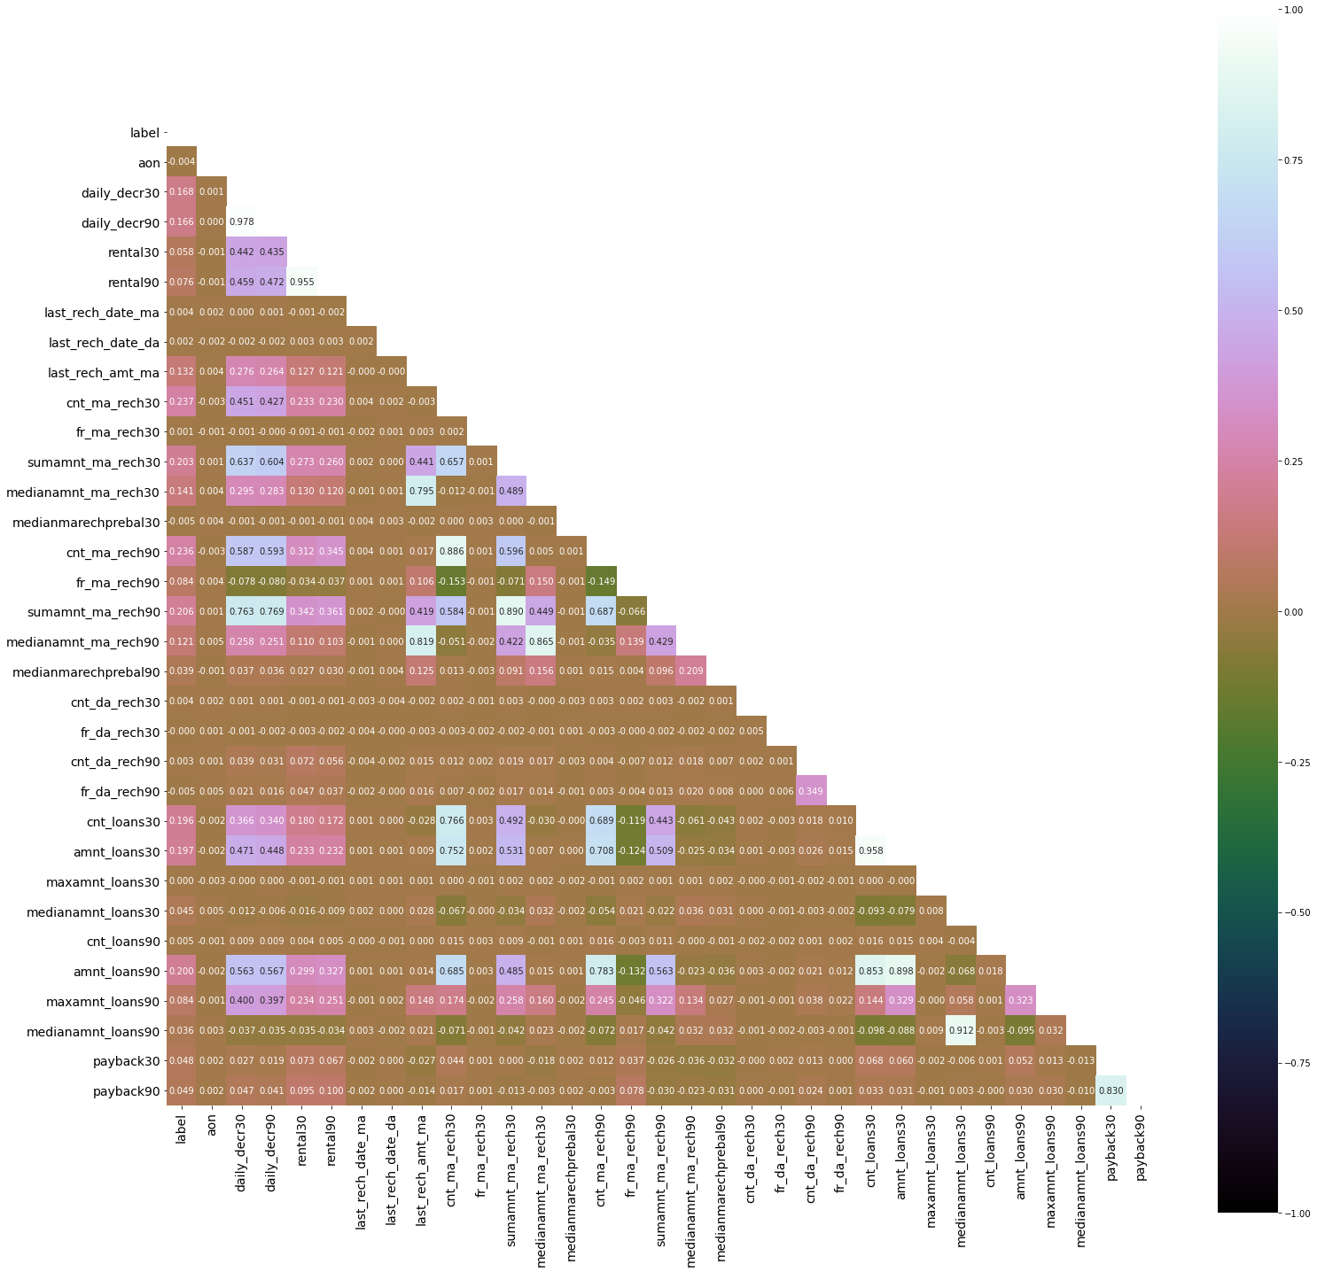
Multivariate Analysis
The heatmap was used to assess the association between the label and feature data columns in particular.
We also looked for any issues about multicollinearity in the data from feature columns.

Slide 19
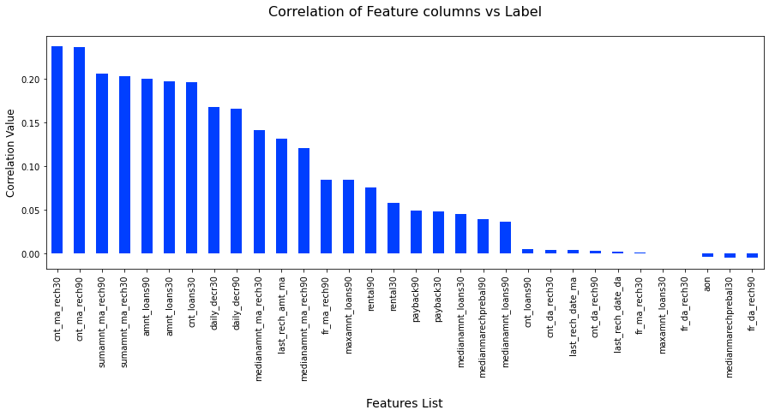
Correlation Bar
We used a Bar Plot to look at the correlation between the label and feature columns to see which are positively and negatively associated.

Slide 20
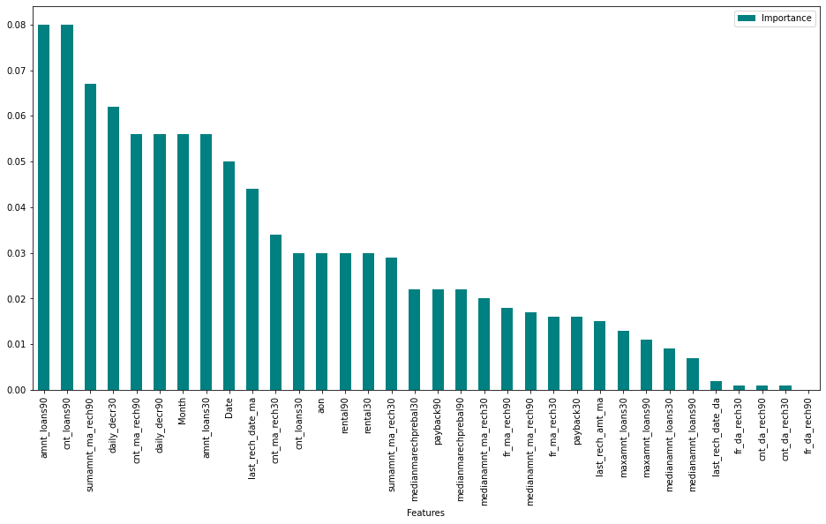
Importance Bar
We were able to obtain the important data by using the Random Forest Classifier, and we were able to exclude the least contributing feature columns.

Slide 21
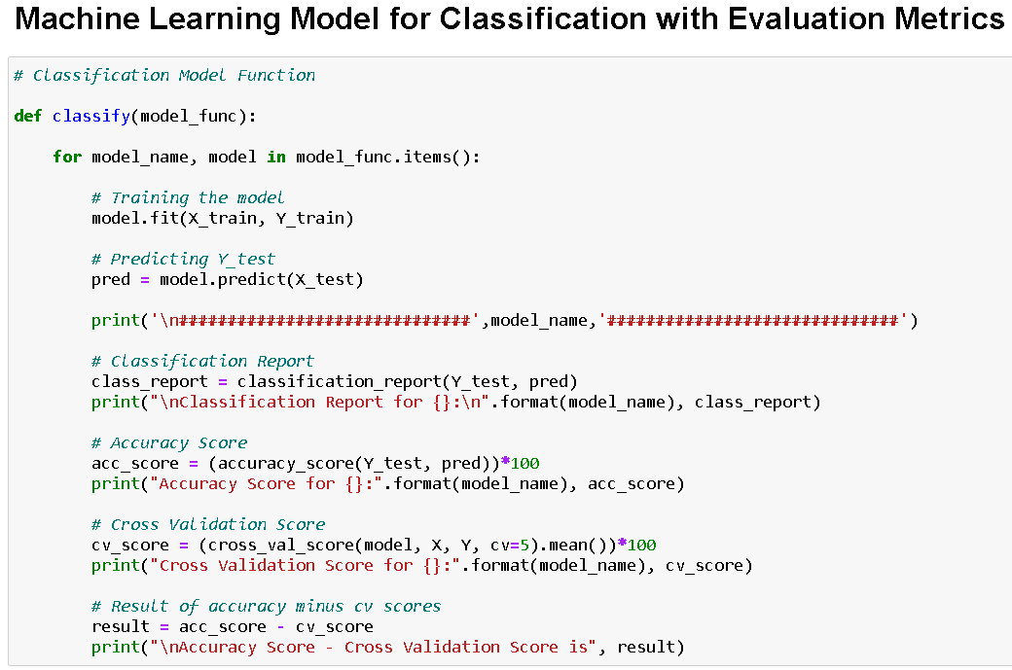
Classification Function
To minimize overfitting and underfitting concerns, I designed this classification function to retrieve the various input model characteristics as well as metric information on accuracy, cross validation, the classification report, and the difference between accuracy and cross validation using 5 folds.

Slide 22
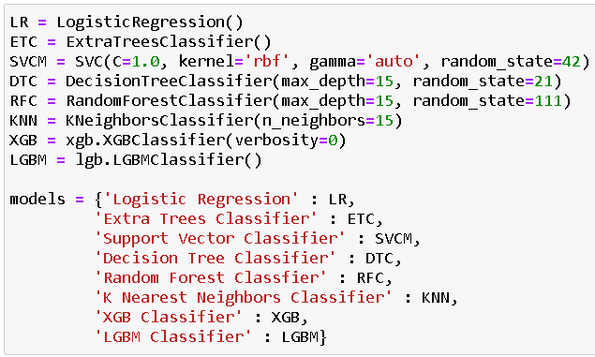
Classification Machine Learning Models Used
To verify for the greatest accuracy and cross validation score, I used 8 Classification Machine Learning Models.

Slide 23
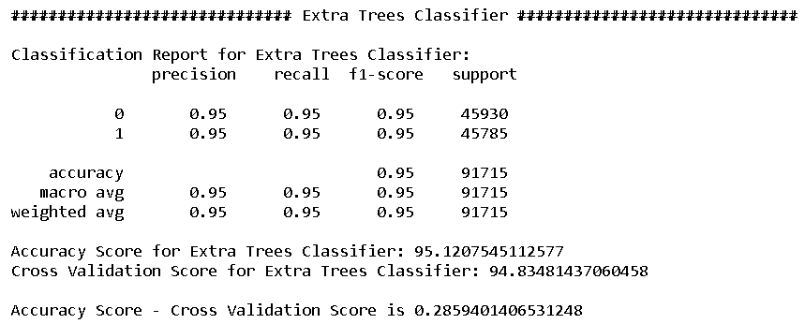
Report on Best Model
Extra Trees Classifier was chosen as my best model, and I then performed hyper parameter tuning on it.

Slide 24
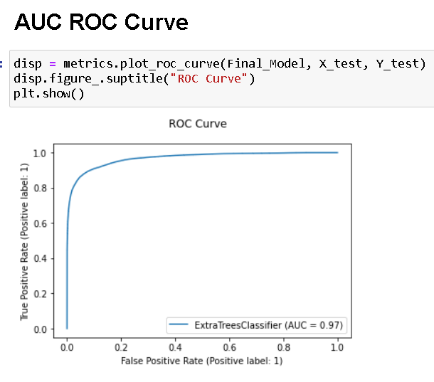
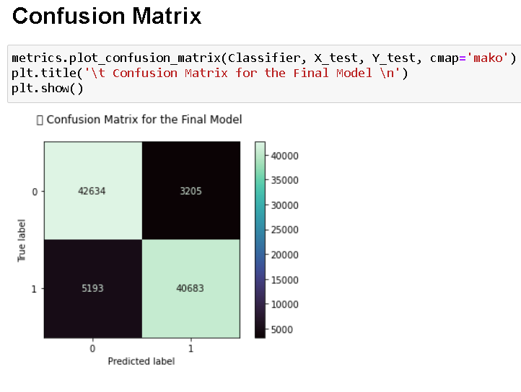
Hyper parameter tuning result

Slide 25
Conclusion
The study's key findings and conclusions are that based on the numerous variables taken into account, an MFI can determine whether a person will return money or not, and whether or not an MFI should issue a load to that individual.
Learning Outcomes of the Study in Data Science: To improve accuracy, I developed numerous classification models rather than relying on a single model, and I used cross validation comparison to guarantee that the model did not suffer from overfitting or underfitting. To improve the scores, I chose the best one and did hyper parameter tuning on it.

Slide 26
Limitations of this work and Scope for Future Work
The limitation is that it will only function for this specific use case, and it will need to be tweaked if used in a new scenario on a similar scale.
The scope is that we can use it in companies to determine whether we should provide a loan to a person or not, and we can also make predictions about a person purchasing an expensive service based on personal details that we have in this dataset, such as the number of times the data account has been recharged in the last 30 days and the daily amount spent from the main account, averaged over the last 30 days (in Indonesian Rupiah), so even a marketing firm can use it.

Slide 27

|
Thank You
Thanks for your attention

